Slide 1
Programación Orientada a Objetos
Herencia y Polimorfismo

Slide 2
Introducción
POO
  Herencia
    Rreusabilidad de software
    Clases se creana partir de otras ya existentes
      Absorven sus atributos y comportamientos
      Y se añaden nuevas capacidades
      Convertible hereda de Automobil
  Polimorfismo
    Permite escribir programas de forma general
      Maneja una variedad de clases existente o por crearse en el futuro
    Ayuda a añadir nuevas capacidades a un sistema

Slide 3
Introducción (cont.)
POO
  Herencia
    Subclase hereda de su superclase
      Subclase usualmente añade atributos y métodos
    Herencia Simple vs. Múltiple
      Java no siporta herencia múltiple
        Interfaces se usan para simular herencia múltiple
        Relación “es un” (“is-a”)
  Composición
    Relación “Tiene un” (“has-a”)

Slide 4
Superclases y Subclases
Relación “es un”
  El Objecto “es un” objeto de otra clase
    Rectangulo “es un” cuadrilatero
      Clase Rectangulo hereda de la clase Cuadrilatero
  Forman estructuras jerárquicas tipo árbol

Slide 5
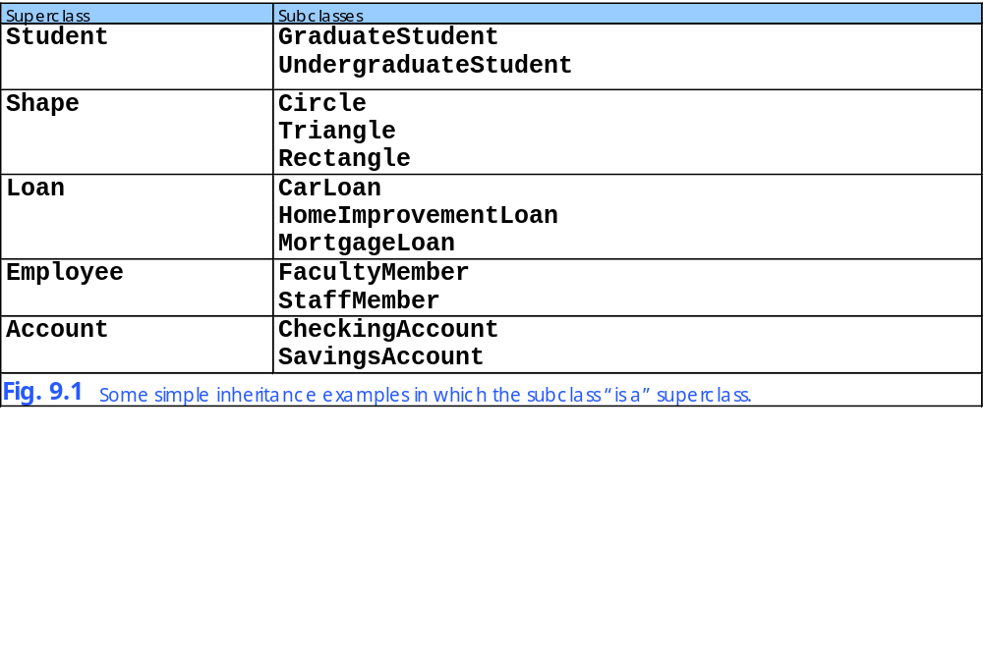

Slide 6
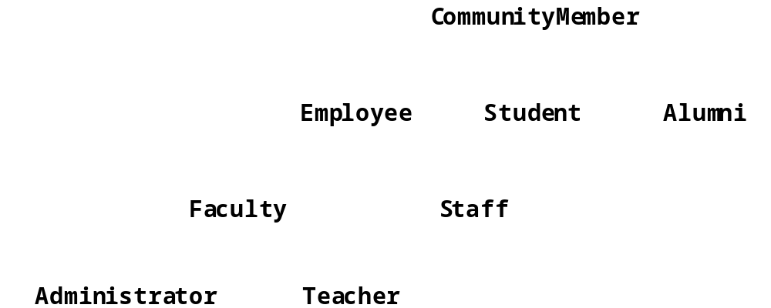
Fig. 9.2 An inheritance hierarchy for university CommunityMembers.
CommunityMember is a direct superclass of Employee
CommunityMember is an indirect superclass of Faculty

Slide 7
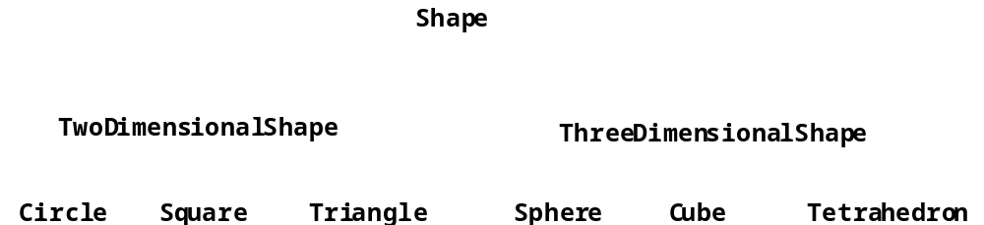
Fig. 9.3 A portion of a Shape class hierarchy.

Slide 8
Miembros protected
Acceso protected
  Entre public y private
  Accesible solo por:
    Los métodos de su superclase
    Los métodos de sus cubclases
    Métodos de clases del mismo paquete

Slide 9
Relación entre objetos superclase y objetos subclase
Objeto subclase
  Puede ser tratado como un objeto superclase
    Al revés no es verdad
      Shape no siempre es un Circle
  Todo clase hereda directo de java.lang.Object
    A menos que se defina otra superclase al definir la clase

Slide 10
Point.java
Line 5 protected members prevent clients from direct access (unless clients are Point subclasses or are in same package)
1 // Fig. 9.4: Point.java
2 // Definition of class Point
3
4 public class Point {
5 protected int x, y; // coordinates of Point
6
7 // No-argument constructor
8 public Point()
9 {
10 // implicit call to superclass constructor occurs here
11 setPoint( 0, 0 );
12 }
13
14 // constructor
15 public Point( int xCoordinate, int yCoordinate )
16 {
17 // implicit call to superclass constructor occurs here
18 setPoint( xCoordinate, yCoordinate );
19 }
20
21 // set x and y coordinates of Point
22 public void setPoint( int xCoordinate, int yCoordinate )
23 {
24 x = xCoordinate;
25 y = yCoordinate;
26 }
27
28 // get x coordinate
29 public int getX()
30 {
31 return x;
32 }
33
protected members prevent clients from direct access (unless clients are Point subclasses or are in same package)

Slide 11
Point.java
34 // get y coordinate
35 public int getY()
36 {
37 return y;
38 }
39
40 // convert into a String representation
41 public String toString()
42 {
43 return "[" + x + ", " + y + "]";
44 }
45
46 } // end class Point

Slide 12
Circle.java
Line 4
Circle is a Point subclass
Line 4
Circle inherits Point’s protected variables and public methods (except for constuctor)
Line 10
Implicit call to Point constructor
Line 19
Explicit call to Point constructor using super
1 // Fig. 9.5: Circle.java
2 // Definition of class Circle
3
4 public class Circle extends Point { // inherits from Point
5 protected double radius;
6
7 // no-argument constructor
8 public Circle()
9 {
10 // implicit call to superclass constructor occurs here
11 setRadius( 0 );
12 }
13
14 // constructor
15 public Circle( double circleRadius, int xCoordinate,
16 int yCoordinate )
17 {
18 // call superclass constructor to set coordinates
19 super( xCoordinate, yCoordinate );
20
21 // set radius
22 setRadius( circleRadius );
23 }
24
25 // set radius of Circle
26 public void setRadius( double circleRadius )
27 {
28 radius = ( circleRadius >= 0.0 ? circleRadius : 0.0 );
29 }
30
Circle is a Point subclass
Circle inherits Point’s protected variables and public methods (except for constuctor)
Implicit call to Point constructor
Explicit call to Point constructor using super

Slide 13
Circle.java
Lines 44-48
Override method toString of class Point by using same signature
31 // get radius of Circle
32 public double getRadius()
33 {
34 return radius;
35 }
36
37 // calculate area of Circle
38 public double area()
39 {
40 return Math.PI * radius * radius;
41 }
42
43 // convert the Circle to a String
44 public String toString()
45 {
46 return "Center = " + "[" + x + ", " + y + "]" +
47 "; Radius = " + radius;
48 }
49
50 } // end class Circle
Override method toString of class Point by using same signature

Slide 14
InheritanceTest.java
Lines 18-19
Instantiate objects
Line 22
Circle invokes method toString
Line 26
Superclass object references subclass
Line 29
Point invokes Circle’s toString method
Line 33
Downcast Point to Circle
1 // Fig. 9.6: InheritanceTest.java
2 // Demonstrating the "is a" relationship
3
4 // Java core packages
5 import java.text.DecimalFormat;
6
7 // Java extension packages
8 import javax.swing.JOptionPane;
9
10 public class InheritanceTest {
11
12 // test classes Point and Circle
13 public static void main( String args[] )
14 {
15 Point point1, point2;
16 Circle circle1, circle2;
17
18 point1 = new Point( 30, 50 );
19 circle1 = new Circle( 2.7, 120, 89 );
20
21 String output = "Point point1: " + point1.toString() +
22 "\nCircle circle1: " + circle1.toString();
23
24 // use "is a" relationship to refer to a Circle
25 // with a Point reference
26 point2 = circle1; // assigns Circle to a Point reference
27
28 output += "\n\nCircle circle1 (via point2 reference): " +
29 point2.toString();
30
31 // use downcasting (casting a superclass reference to a
32 // subclass data type) to assign point2 to circle2
33 circle2 = ( Circle ) point2;
34
Instantiate Point and Circle objects
Circle invokes its overridden toString method
Superclass object can reference subclass object
Point still invokes Circle’s overridden toString method
Downcast Point to Circle

Slide 15
InheritanceTest.java
Line 36
Circle invokes its overridden toString method
Line 40
Circle invokes method area
Line 43
Use instanceof to determine if Point refers to Circle
Line 44
If Point refers to Circle, cast Point as Circle
Circle invokes its overridden toString method
35 output += "\n\nCircle circle1 (via circle2): " +
36 circle2.toString();
37
38 DecimalFormat precision2 = new DecimalFormat( "0.00" );
39 output += "\nArea of c (via circle2): " +
40 precision2.format( circle2.area() );
41
42 // attempt to refer to Point object with Circle reference
43 if ( point1 instanceof Circle ) {
44 circle2 = ( Circle ) point1;
45 output += "\n\ncast successful";
46 }
47 else
48 output += "\n\npoint1 does not refer to a Circle";
49
50 JOptionPane.showMessageDialog( null, output,
51 "Demonstrating the \"is a\" relationship",
52 JOptionPane.INFORMATION_MESSAGE );
53
54 System.exit( 0 );
55 }
56
57 } // end class InheritanceTest
Circle invokes method area
Use instanceof to determine if Point refers to Circle
If Point refers to Circle, cast Point as Circle

Slide 16
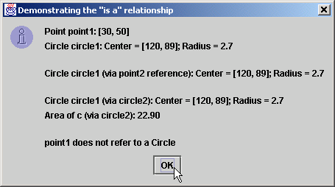
Fig. 9.6 Assigning subclass references to superclass references

Slide 17
Constructores y Finalizers en Subclases
Constructor de una subclase
  Inicializa variables de instancia de la subclase
  Que no fueron heredados de su superclase
  Llamado
    Implicitamente o explicitamente usando super

Slide 18
Constructores y Finalizers en Subclases (cont.)
Método finalize
  Recolección de basura (Garbage collection)
  Método finalize de la subclase
    Debería invocar al método finalize de la superclase

Slide 19
Point.java
Lines 7-20
Superclass constructors
Lines 23-26
Superclass finalize method uses protected for subclass access, but not for other clients
1 // Fig. 9.7: Point.java
2 // Definition of class Point
3 public class Point extends Object {
4 protected int x, y; // coordinates of the Point
5
6 // no-argument constructor
7 public Point()
8 {
9 x = 0;
10 y = 0;
11 System.out.println( "Point constructor: " + this );
12 }
13
14 // constructor
15 public Point( int xCoordinate, int yCoordinate )
16 {
17 x = xCoordinate;
18 y = yCoordinate;
19 System.out.println( "Point constructor: " + this );
20 }
21
22 // finalizer
23 protected void finalize()
24 {
25 System.out.println( "Point finalizer: " + this );
26 }
27
28 // convert Point into a String representation
29 public String toString()
30 {
31 return "[" + x + ", " + y + "]";
32 }
33
34 } // end class Point
Superclass constructors
Superclass finalize method uses protected for subclass access, but not for other clients

Slide 20
Circle.java
Line 9
Implicit call to Point constructor
Line 19
Explicit call to Point constructor using super
Lines 26-30
Override Point’s method finalize, but call it using super
1 // Fig. 9.8: Circle.java
2 // Definition of class Circle
3 public class Circle extends Point { // inherits from Point
4 protected double radius;
5
6 // no-argument constructor
7 public Circle()
8 {
9 // implicit call to superclass constructor here
10 radius = 0;
11 System.out.println( "Circle constructor: " + this );
12 }
13
14 // Constructor
15 public Circle( double circleRadius, int xCoordinate,
16 int yCoordinate )
17 {
18 // call superclass constructor
19 super( xCoordinate, yCoordinate );
20
21 radius = circleRadius;
22 System.out.println( "Circle constructor: " + this );
23 }
24
25 // finalizer
26 protected void finalize()
27 {
28 System.out.println( "Circle finalizer: " + this );
29 super.finalize(); // call superclass finalize method
30 }
31
Implicit call to Point constructor
Explicit call to Point constructor using super
Override Point’s method finalize, but call it using super

Slide 21
Circle.java
32 // convert the Circle to a String
33 public String toString()
34 {
35 return "Center = " + super.toString() +
36 "; Radius = " + radius;
37 }
38
39 } // end class Circle

Slide 22
Test.java
Lines 10-11
Instantiate Circle objects
Line 17
Invoke Circle’s method finalize by calling System.gc
1 // Fig. 9.9: Test.java
2 // Demonstrate when superclass and subclass
3 // constructors and finalizers are called.
4 public class Test {
5
6 // test when constructors and finalizers are called
7 public static void main( String args[] )
8 {
9 Circle circle1, circle2;
10
11 circle1 = new Circle( 4.5, 72, 29 );
12 circle2 = new Circle( 10, 5, 5 );
13
14 circle1 = null; // mark for garbage collection
15 circle2 = null; // mark for garbage collection
16
17 System.gc(); // call the garbage collector
18 }
19
20 } // end class Test
Instantiate Circle objects
Invoke Circle’s method finalize by calling System.gc
Point constructor: Center = [72, 29]; Radius = 0.0
Circle constructor: Center = [72, 29]; Radius = 4.5
Point constructor: Center = [5, 5]; Radius = 0.0
Circle constructor: Center = [5, 5]; Radius = 10.0
Circle finalizer: Center = [72, 29]; Radius = 4.5
Point finalizer: Center = [72, 29]; Radius = 4.5
Circle finalizer: Center = [5, 5]; Radius = 10.0
Point finalizer: Center = [5, 5]; Radius = 10.0

Slide 23
Conversión implícita de subclase a superclase
Referencias de las clases
  Conversión implicita
    Subclase a superclase
      El objeto subclase “es un” objeto superclase
  4 formas:
    Objeto superclase como superclase
    Objeto subclase como subclase
    Objeto subclase como superclase
      Sólo puede usar métodos y atributos de la superclase
    Objeto superclase cómo subclase
      ERROR

Slide 24
Ing. De Software con Herencia
Herencia
  Crear subclases de clase ya existentes (superclase)
    La creación de la subclase no afecta a la superclase
  La nueva clase hereda atributos y métodos
  Reuso de software

Slide 25
Composición vs. Herencia
Herencia
  “Es un”
  Profesor es un Empleado
Composición
  “Tiene un”
  Empleado tiene un CorreoElectronico

Slide 26
Caso de estudio: Point, Cylinder, Circle
Jerarquía point, circle, cylinder
  Point es la superclase
  Circle es subclase de Point
  Cylinder es subclase de Circle

Slide 27
Point.java
Line 6 protected members prevent clients from direct access (unless clients are Point subclasses or are in same package)
Lines 9-20
Constructor and overloaded constructor
1 // Fig. 9.10: Point.java
2 // Definition of class Point
3 package com.deitel.jhtp4.ch09;
4
5 public class Point {
6 protected int x, y; // coordinates of Point
7
8 // No-argument constructor
9 public Point()
10 {
11 // implicit call to superclass constructor occurs here
12 setPoint( 0, 0 );
13 }
14
15 // constructor
16 public Point( int xCoordinate, int yCoordinate )
17 {
18 // implicit call to superclass constructor occurs here
19 setPoint( xCoordinate, yCoordinate );
20 }
21
22 // set x and y coordinates of Point
23 public void setPoint( int xCoordinate, int yCoordinate )
24 {
25 x = xCoordinate;
26 y = yCoordinate;
27 }
28
29 // get x coordinate
30 public int getX()
31 {
32 return x;
33 }
34
protected members prevent clients from direct access (unless clients are Point subclasses or are in same package)
Constructor and overloaded constructor

Slide 28
Point.java
35 // get y coordinate
36 public int getY()
37 {
38 return y;
39 }
40
41 // convert into a String representation
42 public String toString()
43 {
44 return "[" + x + ", " + y + "]";
45 }
46
47 } // end class Point

Slide 29
Test.java
Line 15
Instantiate Point object
Lines 18-19
Methods getX and getY read Point’s protected variables
1 // Fig. 9.11: Test.java
2 // Applet to test class Point
3
4 // Java extension packages
5 import javax.swing.JOptionPane;
6
7 // Deitel packages
8 import com.deitel.jhtp4.ch09.Point;
9
10 public class Test {
11
12 // test class Point
13 public static void main( String args[] )
14 {
15 Point point = new Point( 72, 115 );
16
17 // get coordinates
18 String output = "X coordinate is " + point.getX() +
19 "\nY coordinate is " + point.getY();
20
21 // set coordinates
22 point.setPoint( 10, 10 );
23
24 // use implicit call to point.toString()
25 output += "\n\nThe new location of point is " + point;
26
27 JOptionPane.showMessageDialog( null, output,
28 "Demonstrating Class Point",
29 JOptionPane.INFORMATION_MESSAGE );
30
31 System.exit( 0 );
32 }
33
34 } // end class Test
Instantiate Point object
Methods getX and getY read Point’s protected variables

Slide 30
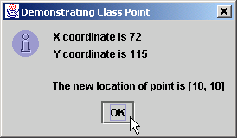
Fig. 9.11 Testing class Point

Slide 31
Circle.java
Line 5
Circle is a Point subclass
Line 5
Circle inherits Point’s protected variables and public methods (except for constuctor)
Line 11
Implicit call to Point constructor
Line 20 explicit call to Point constructor using super
1 // Fig. 9.12: Circle.java
2 // Definition of class Circle
3 package com.deitel.jhtp4.ch09;
4
5 public class Circle extends Point { // inherits from Point
6 protected double radius;
7
8 // no-argument constructor
9 public Circle()
10 {
11 // implicit call to superclass constructor occurs here
12 setRadius( 0 );
13 }
14
15 // constructor
16 public Circle( double circleRadius, int xCoordinate,
17 int yCoordinate )
18 {
19 // call superclass constructor to set coordinates
20 super( xCoordinate, yCoordinate );
21
22 // set radius
23 setRadius( circleRadius );
24 }
25
26 // set radius of Circle
27 public void setRadius( double circleRadius )
28 {
29 radius = ( circleRadius >= 0.0 ? circleRadius : 0.0 );
30 }
31
Circle is a Point subclass
Circle inherits Point’s protected variables and public methods (except for constuctor)
Implicit call to Point constructor
Explicit call to Point constructor using super

Slide 32
Circle.java
32 // get radius of Circle
33 public double getRadius()
34 {
35 return radius;
36 }
37
38 // calculate area of Circle
39 public double area()
40 {
41 return Math.PI * radius * radius;
42 }
43
44 // convert the Circle to a String
45 public String toString()
46 {
47 return "Center = " + "[" + x + ", " + y + "]" +
48 "; Radius = " + radius;
49 }
50
51 } // end class Circle

Slide 33
Test.java
Line 19
Instantiate Circle object
Lines 25 and 28
Calls to methods getRadius and setRadius read and manipulate Circle’s protected variables
Lines 23-24 and 29 Calls to methods getX, getY and setPoint read and manipulate Circle’s inherited protected variables
1 // Fig. 9.13: Test.java
2 // Applet to test class Circle
3
4 // Java core packages
5 import java.text.DecimalFormat;
6
7 // Java extension packages
8 import javax.swing.JOptionPane;
9
10 // Deitel packages
11 import com.deitel.jhtp4.ch09.Circle;
12
13 public class Test {
14
15 // test class Circle
16 public static void main( String args[] )
17 {
18 // create a Circle
19 Circle circle = new Circle( 2.5, 37, 43 );
20 DecimalFormat precision2 = new DecimalFormat( "0.00" );
21
22 // get coordinates and radius
23 String output = "X coordinate is " + circle.getX() +
24 "\nY coordinate is " + circle.getY() +
25 "\nRadius is " + circle.getRadius();
26
27 // set coordinates and radius
28 circle.setRadius( 4.25 );
29 circle.setPoint( 2, 2 );
30
31 // get String representation of Circle and calculate area
32 output +=
33 "\n\nThe new location and radius of c are\n" + circle +
34 "\nArea is " + precision2.format( circle.area() );
35
Instantiate Circle object
Calls to methods getRadius and setRadius read and manipulate Circle’s protected variables
Calls to methods getX, getY and setPoint read and manipulate Circle’s inherited protected variables

Slide 34
Test.java
36 JOptionPane.showMessageDialog( null, output,
37 "Demonstrating Class Circle",
38 JOptionPane.INFORMATION_MESSAGE );
39
40 System.exit( 0 );
41 }
42
43 } // end class Test

Slide 35
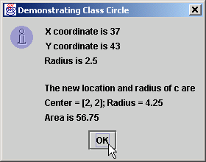
Fig. 9.13 Testing class Circle

Slide 36
Cylinder.java
Line 5
Cylinder is a Circle subclass
Line 5
Cylinder inherits Point’s and Circle’s protected variables and public methods (except for constuctors)
Line 11
Implicit call to Circle constructor
Line 20
Explicit call to Circle constructor using super
1 // Fig. 9.14: Cylinder.java
2 // Definition of class Cylinder
3 package com.deitel.jhtp4.ch09;
4
5 public class Cylinder extends Circle {
6 protected double height; // height of Cylinder
7
8 // no-argument constructor
9 public Cylinder()
10 {
11 // implicit call to superclass constructor here
12 setHeight( 0 );
13 }
14
15 // constructor
16 public Cylinder( double cylinderHeight, double cylinderRadius,
17 int xCoordinate, int yCoordinate )
18 {
19 // call superclass constructor to set coordinates/radius
20 super( cylinderRadius, xCoordinate, yCoordinate );
21
22 // set cylinder height
23 setHeight( cylinderHeight );
24 }
25
26 // set height of Cylinder
27 public void setHeight( double cylinderHeight )
28 {
29 height = ( cylinderHeight >= 0 ? cylinderHeight : 0 );
30 }
31
Cylinder is a Circle subclass
Cylinder inherits Point’s and Circle’s protected variables and public methods (except for constuctors)
Implicit call to Circle constructor
Explicit call to Circle constructor using super

Slide 37
Cylinder.java
Lines 39-43
Override method area of class Circle
32 // get height of Cylinder
33 public double getHeight()
34 {
35 return height;
36 }
37
38 // calculate area of Cylinder (i.e., surface area)
39 public double area()
40 {
41 return 2 * super.area() +
42 2 * Math.PI * radius * height;
43 }
44
45 // calculate volume of Cylinder
46 public double volume()
47 {
48 return super.area() * height;
49 }
50
51 // convert the Cylinder to a String
52 public String toString()
53 {
54 return super.toString() + "; Height = " + height;
55 }
56
57 } // end class Cylinder
Override method area of class Circle

Slide 38
Test.java
Line 19
Instantiate Cylinder object
Lines 23-31
Method calls read and manipulate Cylinder’s protected variables and inherited protected variables
1 // Fig. 9.15: Test.java
2 // Application to test class Cylinder
3
4 // Java core packages
5 import java.text.DecimalFormat;
6
7 // Java extension packages
8 import javax.swing.JOptionPane;
9
10 // Deitel packages
11 import com.deitel.jhtp4.ch09.Cylinder;
12
13 public class Test {
14
15 // test class Cylinder
16 public static void main( String args[] )
17 {
18 // create Cylinder
19 Cylinder cylinder = new Cylinder( 5.7, 2.5, 12, 23 );
20 DecimalFormat precision2 = new DecimalFormat( "0.00" );
21
22 // get coordinates, radius and height
23 String output = "X coordinate is " + cylinder.getX() +
24 "\nY coordinate is " + cylinder.getY() +
25 "\nRadius is " + cylinder.getRadius() +
26 "\nHeight is " + cylinder.getHeight();
27
28 // set coordinates, radius and height
29 cylinder.setHeight( 10 );
30 cylinder.setRadius( 4.25 );
31 cylinder.setPoint( 2, 2 );
32
Instantiate Cylinder object
Method calls read and manipulate Cylinder’s protected variables and inherited protected variables

Slide 39
Test.java
33 // get String representation of Cylinder and calculate
34 // area and volume
35 output += "\n\nThe new location, radius " +
36 "and height of cylinder are\n" + cylinder +
37 "\nArea is " + precision2.format( cylinder.area() ) +
38 "\nVolume is " + precision2.format( cylinder.volume() );
39
40 JOptionPane.showMessageDialog( null, output,
41 "Demonstrating Class Cylinder",
42 JOptionPane.INFORMATION_MESSAGE );
43
44 System.exit( 0 );
45 }
46
47 } // end class Test

Slide 40
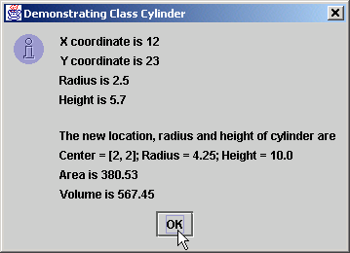
Fig. 9.15 Testing class Test

Slide 41
Introducción al Polimorfismo
Polimorfismo
  Ayuda a crear sistemas extensibles
  El programa procesa objetos como si fueran de la superclase
    Permite añadir clase al sistema de forma fácil
      Clases deben ser parte de una jerarquía

Slide 42
Switch según tipo de objeto
Alternativa basada en switch
  Determinar la acción apropiada a ejecutar
    Basada en el tipo de objeto
  Propenso a errores
    Programador se le olvida compaarr bien los tipos
    Se olvida de añadir o sacar elementos del switch

Slide 43
Enlace dinámico de métodos
Qué es?
  Implementa procesamiento polimórfico de objetos
  Usa referencia de superclase para referirse a la sublase
  El programa escoje el método “correcto” en la subclase

Slide 44
Enlace dinámico de métodos (cont.)
Ejemplo:
  Superclase Shape
  Subclases Circle, Rectangle y Square
  Cada clase se dibuja de acuerdo a su tipo
    Shape tiene el método draw
    Cada sublase hace un override del método draw
    Se llama al método draw de la superclase Shape
      Programa determina dinámicamente cuál método draw (de cuál clase) invocar

Slide 45
Métodos y Clases final
Método final
  La subclase no la puede modificar
Clase final
  No puede ser superclase (no puede aplicarsele extended)
    Ninguna clase puede heredar de una clase final

Slide 46
Superclases Abstractas y Clases concretas
Clases abstractas
  No puede tener objetos instanciados
  Muy genérica para ser usada en objetos reales
    TwoDimensionalShape
  Proporciona un esqueleto para definir clases concretas
    “Superclases abstractas”
Clases concretas
  Clases que si pueden tener objetos instanciados
  Son más detalladas
    Square, Circle y Triangle

Slide 47
Ejemplos de polimorfismo
Juego de video
  Superclase GamePiece
    Contiene método drawYourself
  Subclases Martian, Venutian, LaserBeam, etc.
    Override del método drawYourself
      Martian se dibuja con antena
      LaserBeam se dibuja como una línea roja
      Esto es polimorfismo
  Se extiende facilmente
    Suponga que añadimos la clase Mercurian
      Mercurian hereda de GamePiece
      Overrides del método drawYourself

Slide 48
Caso de Estudio: planillas usando polimorfismo
Métodos abstractos y polimorfismo
  Superclase abstracta Employee
    Método earnings se aplica a todos los empleados
    Pero depende del tipo de Employee
  Subclases concretas de Employee declaradas final
    Boss
    CommissionWorker
    PieceWorker
    HourlyWorker

Slide 49
Employee.java
Line 4 abstract class cannot be instantiated
Lines 5-6 and 16-30 abstract class can have instance data and nonabstract methods for subclasses
Lines 9-13 abstract class can have constructors for subclasses to initialize inherited data
1 // Fig. 9.16: Employee.java
2 // Abstract base class Employee.
3
4 public abstract class Employee {
5 private String firstName;
6 private String lastName;
7
8 // constructor
9 public Employee( String first, String last )
10 {
11 firstName = first;
12 lastName = last;
13 }
14
15 // get first name
16 public String getFirstName()
17 {
18 return firstName;
19 }
20
21 // get last name
22 public String getLastName()
23 {
24 return lastName;
25 }
26
27 public String toString()
28 {
29 return firstName + ' ' + lastName;
30 }
31
abstract class cannot be instantiated
abstract class can have instance data and nonabstract methods for subclasses
abstract class can have constructors for subclasses to initialize inherited data

Slide 50
Employee.java
Line 35
Subclasses must implement abstract method
32 // Abstract method that must be implemented for each
33 // derived class of Employee from which objects
34 // are instantiated.
35 public abstract double earnings();
36
37 } // end class Employee
Subclasses must implement abstract method

Slide 51
Boss.java
Line 4
Boss is an Employee subclass
Line 4
Boss inherits Employee’s public methods (except for constuctor)
Line 10
Explicit call to Employee constructor using super
Lines 21-24
Required to implement Employee’s method earnings (polymorphism)
1 // Fig. 9.17: Boss.java
2 // Boss class derived from Employee.
3
4 public final class Boss extends Employee {
5 private double weeklySalary;
6
7 // constructor for class Boss
8 public Boss( String first, String last, double salary )
9 {
10 super( first, last ); // call superclass constructor
11 setWeeklySalary( salary );
12 }
13
14 // set Boss's salary
15 public void setWeeklySalary( double salary )
16 {
17 weeklySalary = ( salary > 0 ? salary : 0 );
18 }
19
20 // get Boss's pay
21 public double earnings()
22 {
23 return weeklySalary;
24 }
25
26 // get String representation of Boss's name
27 public String toString()
28 {
29 return "Boss: " + super.toString();
30 }
31
32 } // end class Boss
Boss is an Employee subclass
Boss inherits Employee’s public methods (except for constuctor)
Explicit call to Employee constructor using super
Required to implement Employee’s method earnings (polymorphism)

Slide 52
CommissionWorker.java
Line 4
CommissionWorker is an Employee subclass
Line 13
Explicit call to Employee constructor using super
CommissionWorker is an Employee subclass
1 // Fig. 9.18: CommissionWorker.java
2 // CommissionWorker class derived from Employee
3
4 public final class CommissionWorker extends Employee {
5 private double salary; // base salary per week
6 private double commission; // amount per item sold
7 private int quantity; // total items sold for week
8
9 // constructor for class CommissionWorker
10 public CommissionWorker( String first, String last,
11 double salary, double commission, int quantity )
12 {
13 super( first, last ); // call superclass constructor
14 setSalary( salary );
15 setCommission( commission );
16 setQuantity( quantity );
17 }
18
19 // set CommissionWorker's weekly base salary
20 public void setSalary( double weeklySalary )
21 {
22 salary = ( weeklySalary > 0 ? weeklySalary : 0 );
23 }
24
25 // set CommissionWorker's commission
26 public void setCommission( double itemCommission )
27 {
28 commission = ( itemCommission > 0 ? itemCommission : 0 );
29 }
30
Explicit call to Employee constructor using super

Slide 53
CommissionWorker.java
Lines 38-41
Required to implement Employee’s method earnings; this implementation differs from that in Boss
31 // set CommissionWorker's quantity sold
32 public void setQuantity( int totalSold )
33 {
34 quantity = ( totalSold > 0 ? totalSold : 0 );
35 }
36
37 // determine CommissionWorker's earnings
38 public double earnings()
39 {
40 return salary + commission * quantity;
41 }
42
43 // get String representation of CommissionWorker's name
44 public String toString()
45 {
46 return "Commission worker: " + super.toString();
47 }
48
49 } // end class CommissionWorker
Required to implement Employee’s method earnings; this implementation differs from that in Boss

Slide 54
PieceWorker.java
Line 4
PieceWorker is an
Employee subclass
Line 12
Explicit call to Employee constructor using super
Lines 30-33 Implementation of Employee’s method earnings; differs from that of Boss and CommissionWorker
PieceWorker is an Employee subclass
1 // Fig. 9.19: PieceWorker.java
2 // PieceWorker class derived from Employee
3
4 public final class PieceWorker extends Employee {
5 private double wagePerPiece; // wage per piece output
6 private int quantity; // output for week
7
8 // constructor for class PieceWorker
9 public PieceWorker( String first, String last,
10 double wage, int numberOfItems )
11 {
12 super( first, last ); // call superclass constructor
13 setWage( wage );
14 setQuantity( numberOfItems);
15 }
16
17 // set PieceWorker's wage
18 public void setWage( double wage )
19 {
20 wagePerPiece = ( wage > 0 ? wage : 0 );
21 }
22
23 // set number of items output
24 public void setQuantity( int numberOfItems )
25 {
26 quantity = ( numberOfItems > 0 ? numberOfItems : 0 );
27 }
28
29 // determine PieceWorker's earnings
30 public double earnings()
31 {
32 return quantity * wagePerPiece;
33 }
34
Explicit call to Employee constructor using super
Implementation of Employee’s method earnings; differs from that of Boss and CommissionWorker

Slide 55
PieceWorker.java
35 public String toString()
36 {
37 return "Piece worker: " + super.toString();
38 }
39
40 } // end class PieceWorker

Slide 56
HourlyWorker.java
Line 4
PieceWorker is an
Employee subclass
Line 12
Explicit call to Employee constructor using super
Line 31
Implementation of Employee’s method earnings; differs from that of other Employee subclasses
HourlyWorker is an Employee subclass
1 // Fig. 9.20: HourlyWorker.java
2 // Definition of class HourlyWorker
3
4 public final class HourlyWorker extends Employee {
5 private double wage; // wage per hour
6 private double hours; // hours worked for week
7
8 // constructor for class HourlyWorker
9 public HourlyWorker( String first, String last,
10 double wagePerHour, double hoursWorked )
11 {
12 super( first, last ); // call superclass constructor
13 setWage( wagePerHour );
14 setHours( hoursWorked );
15 }
16
17 // Set the wage
18 public void setWage( double wagePerHour )
19 {
20 wage = ( wagePerHour > 0 ? wagePerHour : 0 );
21 }
22
23 // Set the hours worked
24 public void setHours( double hoursWorked )
25 {
26 hours = ( hoursWorked >= 0 && hoursWorked < 168 ?
27 hoursWorked : 0 );
28 }
29
30 // Get the HourlyWorker's pay
31 public double earnings() { return wage * hours; }
32
Explicit call to Employee constructor using super
Implementation of Employee’s method earnings; differs from that of other Employee subclasses

Slide 57
HourlyWorker.java
33 public String toString()
34 {
35 return "Hourly worker: " + super.toString();
36 }
37
38 } // end class HourlyWorker

Slide 58
Test.java
Line 15
Test cannot instantiate Employee but can reference one
Lines 18-28
Instantiate one instance each of Employee subclasses
1 // Fig. 9.21: Test.java
2 // Driver for Employee hierarchy
3
4 // Java core packages
5 import java.text.DecimalFormat;
6
7 // Java extension packages
8 import javax.swing.JOptionPane;
9
10 public class Test {
11
12 // test Employee hierarchy
13 public static void main( String args[] )
14 {
15 Employee employee; // superclass reference
16 String output = "";
17
18 Boss boss = new Boss( "John", "Smith", 800.0 );
19
20 CommissionWorker commisionWorker =
21 new CommissionWorker(
22 "Sue", "Jones", 400.0, 3.0, 150 );
23
24 PieceWorker pieceWorker =
25 new PieceWorker( "Bob", "Lewis", 2.5, 200 );
26
27 HourlyWorker hourlyWorker =
28 new HourlyWorker( "Karen", "Price", 13.75, 40 );
29
30 DecimalFormat precision2 = new DecimalFormat( "0.00" );
31
Test cannot instantiate Employee but can reference one
Instantiate one instance each of Employee subclasses

Slide 59
Test.java
Line 33
Use Employee to reference Boss
Line 36
Method employee.earnings dynamically binds to method boss.earnings
Lines 41-55
Do same for CommissionWorker and PieceWorker
Use Employee to reference Boss
32 // Employee reference to a Boss
33 employee = boss;
34
35 output += employee.toString() + " earned $" +
36 precision2.format( employee.earnings() ) + "\n" +
37 boss.toString() + " earned $" +
38 precision2.format( boss.earnings() ) + "\n";
39
40 // Employee reference to a CommissionWorker
41 employee = commissionWorker;
42
43 output += employee.toString() + " earned $" +
44 precision2.format( employee.earnings() ) + "\n" +
45 commissionWorker.toString() + " earned $" +
46 precision2.format(
47 commissionWorker.earnings() ) + "\n";
48
49 // Employee reference to a PieceWorker
50 employee = pieceWorker;
51
52 output += employee.toString() + " earned $" +
53 precision2.format( employee.earnings() ) + "\n" +
54 pieceWorker.toString() + " earned $" +
55 precision2.format( pieceWorker.earnings() ) + "\n";
56
Method employee.earnings dynamically binds to method boss.earnings
Do same for CommissionWorker and PieceWorker

Slide 60
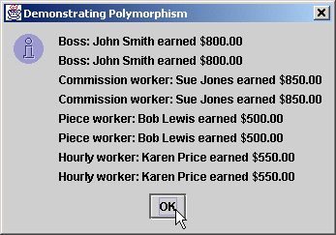
Test.java
Lines 58-63
Repeat for HourlyWorker
57 // Employee reference to an HourlyWorker
58 employee = hourlyWorker;
59
60 output += employee.toString() + " earned $" +
61 precision2.format( employee.earnings() ) + "\n" +
62 hourlyWorker.toString() + " earned $" +
63 precision2.format( hourlyWorker.earnings() ) + "\n";
64
65 JOptionPane.showMessageDialog( null, output,
66 "Demonstrating Polymorphism",
67 JOptionPane.INFORMATION_MESSAGE );
68
69 System.exit( 0 );
70 }
71
72 } // end class Test
Repeat for HourlyWorker

Slide 61
Enlace dinámico y nuevas clases
Enlace dinámico (enlace tardío)
  No se necesita conocer el tipo del objeto al momento de la compilación
  En tiempo de ejecución, la llamada al método es emparejada con el método apropiado

Slide 62
Caso de estudio: heredando interfaces e implementación
Jerarquía Point, Circle, Cylinder
  Modifcar a la clase abstract llamada Shape
    Demonstrar polimorfismo
    Contiene método abstract llamado getName
      Cada subclase debe implementar ese método getName
    Contiene métodos area y volume
      No son abstractos
      Retornan 0 por default
      Cada subclase les hace override

Slide 63
Shape.java
Line 4
Shape cannot be instantiated
Lines 7-16 abstract class can have nonabstract methods for subclasses
Line 20
Concrete subclasses must implement method getName
1 // Fig. 9.22: Shape.java
2 // Definition of abstract base class Shape
3
4 public abstract class Shape extends Object {
5
6 // return shape's area
7 public double area()
8 {
9 return 0.0;
10 }
11
12 // return shape's volume
13 public double volume()
14 {
15 return 0.0;
16 }
17
18 // abstract method must be defined by concrete subclasses
19 // to return appropriate shape name
20 public abstract String getName();
21
22 } // end class Shape
Shape cannot be instantiated
abstract class can have nonabstract methods for subclasses
Concrete subclasses must implement method getName

Slide 64
Point.java
Line 4
Point inherits Shape’s public methods
Line 5 protected members prevent clients from direct access (unless clients are Point subclasses or are in same package)
Point inherits Shape’s public methods
1 // Fig. 9.23: Point.java
2 // Definition of class Point
3
4 public class Point extends Shape {
5 protected int x, y; // coordinates of the Point
6
7 // no-argument constructor
8 public Point()
9 {
10 setPoint( 0, 0 );
11 }
12
13 // constructor
14 public Point( int xCoordinate, int yCoordinate )
15 {
16 setPoint( xCoordinate, yCoordinate );
17 }
18
19 // set x and y coordinates of Point
20 public void setPoint( int xCoordinate, int yCoordinate )
21 {
22 x = xCoordinate;
23 y = yCoordinate;
24 }
25
26 // get x coordinate
27 public int getX()
28 {
29 return x;
30 }
31
protected members prevent clients from direct access (unless clients are Point subclasses or are in same package)

Slide 65
Point.java
Lines 45-48
Implementation of Shape’s method getName
*** Note ***
32 // get y coordinate
33 public int getY()
34 {
35 return y;
36 }
37
38 // convert point into String representation
39 public String toString()
40 {
41 return "[" + x + ", " + y + "]";
42 }
43
44 // return shape name
45 public String getName()
46 {
47 return "Point";
48 }
49
50 } // end class Point
Implementation of Shape’s method getName
Point does not override methods area and volume, because points have neither area nor volume

Slide 66
Circle.java
Line 4
Circle inherits variables/methods from Point and Shape
Lines 5 and 24-34
Methods for reading/setting protected value
Circle inherits variables/methods from Point and Shape
1 // Fig. 9.24: Circle.java
2 // Definition of class Circle
3
4 public class Circle extends Point { // inherits from Point
5 protected double radius;
6
7 // no-argument constructor
8 public Circle()
9 {
10 // implicit call to superclass constructor here
11 setRadius( 0 );
12 }
13
14 // constructor
15 public Circle( double circleRadius, int xCoordinate,
16 int yCoordinate )
17 {
18 // call superclass constructor
19 super( xCoordinate, yCoordinate );
20
21 setRadius( circleRadius );
22 }
23
24 // set radius of Circle
25 public void setRadius( double circleRadius )
26 {
27 radius = ( circleRadius >= 0 ? circleRadius : 0 );
28 }
29
30 // get radius of Circle
31 public double getRadius()
32 {
33 return radius;
34 }
35
Methods for reading/setting protected value

Slide 67
Circle.java
Lines 37-40
Override method area but not method volume (circles do not have volume)
Lines 50-53
Implementation of Shape’s method getName
36 // calculate area of Circle
37 public double area()
38 {
39 return Math.PI * radius * radius;
40 }
41
42 // convert Circle to a String represention
43 public String toString()
44 {
45 return "Center = " + super.toString() +
46 "; Radius = " + radius;
47 }
48
49 // return shape name
50 public String getName()
51 {
52 return "Circle";
53 }
54
55 } // end class Circle
Override method area but not method volume (circles do not have volume)
Implementation of Shape’s method getName

Slide 68
Cylinder.java
Line 4
Cylinder inherits variables and methods from Point, Circle and Shape
Cylinder inherits variables and methods from Point, Circle and Shape
1 // Fig. 9.25: Cylinder.java
2 // Definition of class Cylinder.
3
4 public class Cylinder extends Circle {
5 protected double height; // height of Cylinder
6
7 // no-argument constructor
8 public Cylinder()
9 {
10 // implicit call to superclass constructor here
11 setHeight( 0 );
12 }
13
14 // constructor
15 public Cylinder( double cylinderHeight,
16 double cylinderRadius, int xCoordinate,
17 int yCoordinate )
18 {
19 // call superclass constructor
20 super( cylinderRadius, xCoordinate, yCoordinate );
21
22 setHeight( cylinderHeight );
23 }
24
25 // set height of Cylinder
26 public void setHeight( double cylinderHeight )
27 {
28 height = ( cylinderHeight >= 0 ? cylinderHeight : 0 );
29 }
30

Slide 69
Cylinder.java
Lines 38-47
Override methods area and volume
Lines 56-59 Implementation of Shape’s method getName
31 // get height of Cylinder
32 public double getHeight()
33 {
34 return height;
35 }
36
37 // calculate area of Cylinder (i.e., surface area)
38 public double area()
39 {
40 return 2 * super.area() + 2 * Math.PI * radius * height;
41 }
42
43 // calculate volume of Cylinder
44 public double volume()
45 {
46 return super.area() * height;
47 }
48
49 // convert Cylinder to a String representation
50 public String toString()
51 {
52 return super.toString() + "; Height = " + height;
53 }
54
55 // return shape name
56 public String getName()
57 {
58 return "Cylinder";
59 }
60
61 } // end class Cylinder
Override methods area and volume
Implementation of Shape’s method getName

Slide 70
Test.java
Lines 16-18
Instantiate one instance each of Shape subclasses
Lines 21-30
Create three Shapes to reference each subclass object
1 // Fig. 9.26: Test.java
2 // Class to test Shape, Point, Circle, Cylinder hierarchy
3
4 // Java core packages
5 import java.text.DecimalFormat;
6
7 // Java extension packages
8 import javax.swing.JOptionPane;
9
10 public class Test {
11
12 // test Shape hierarchy
13 public static void main( String args[] )
14 {
15 // create shapes
16 Point point = new Point( 7, 11 );
17 Circle circle = new Circle( 3.5, 22, 8 );
18 Cylinder cylinder = new Cylinder( 10, 3.3, 10, 10 );
19
20 // create Shape array
21 Shape arrayOfShapes[] = new Shape[ 3 ];
22
23 // aim arrayOfShapes[ 0 ] at subclass Point object
24 arrayOfShapes[ 0 ] = point;
25
26 // aim arrayOfShapes[ 1 ] at subclass Circle object
27 arrayOfShapes[ 1 ] = circle;
28
29 // aim arrayOfShapes[ 2 ] at subclass Cylinder object
30 arrayOfShapes[ 2 ] = cylinder;
31
Instantiate one instance each of Shape subclasses
Create three Shapes to reference each subclass object

Slide 71
Test.java
Line 43
Dynamically bind method getName
Line 46
Dynamically bind method area for Circle and Cylinder objects
Line 48
Dynamically bind method volume for Cylinder object
32 // get name and String representation of each shape
33 String output =
34 point.getName() + ": " + point.toString() + "\n" +
35 circle.getName() + ": " + circle.toString() + "\n" +
36 cylinder.getName() + ": " + cylinder.toString();
37
38 DecimalFormat precision2 = new DecimalFormat( "0.00" );
39
40 // loop through arrayOfShapes and get name,
41 // area and volume of each shape in arrayOfShapes
42 for ( int i = 0; i < arrayOfShapes.length; i++ ) {
43 output += "\n\n" + arrayOfShapes[ i ].getName() +
44 ": " + arrayOfShapes[ i ].toString() +
45 "\nArea = " +
46 precision2.format( arrayOfShapes[ i ].area() ) +
47 "\nVolume = " +
48 precision2.format( arrayOfShapes[ i ].volume() );
49 }
50
51 JOptionPane.showMessageDialog( null, output,
52 "Demonstrating Polymorphism",
53 JOptionPane.INFORMATION_MESSAGE );
54
55 System.exit( 0 );
56 }
57
58 } // end class Test
Dynamically bind method getName
Dynamically bind method area for Circle and Cylinder objects
Dynamically bind method volume for Cylinder object

Slide 72
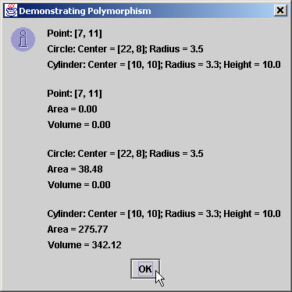
Test.java

